Slide 1

Cash Flow Statement Part 1 - Video

Slide 2
Goals:
Introduce the cash flow statement
Why it’s useful
Basic format

Slide 3

W. T. Grant: income vs. cash flow

Slide 4
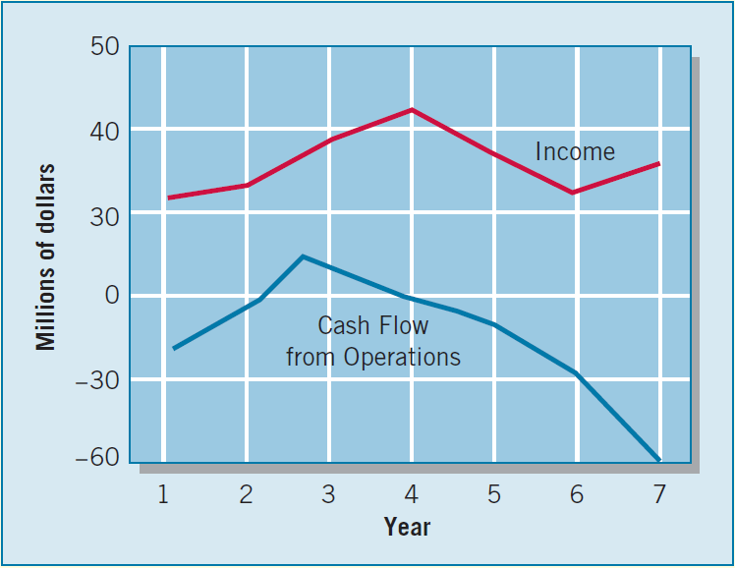
W. T. Grant: income vs. cash flow

Slide 5
What is a cash flow statement?
Financial statement that explains cash inflows and outflows over a period of time.
Operating Cash Inflows/Outflows
$$Cash_{Today} −Cash_{OneYearAgo}=$$
Investing Cash Inflows/Outflows
Financing Cash Inflows/Outflows

Slide 6
Cash Flow Classifications
Operating activities:
Result from delivering or producing goods for sale and providing services. Also result from paying expenses related to those revenue generating activities.
Investing activities:
Result from acquiring and disposing of (1) long-term productive assets or (2) investments that are not considered cash equivalents.
PP&E and other intangible assets (buying and selling)
Investments, including lending money (buying and selling)
Financing activities:
Result from transactions with owners and lenders that provide financial resources to the firm or return/repay those resources.
Transactions with creditors (borrowing and paying off debt)
Transactions with shareholders (raising equity or distributing dividends)

Slide 7
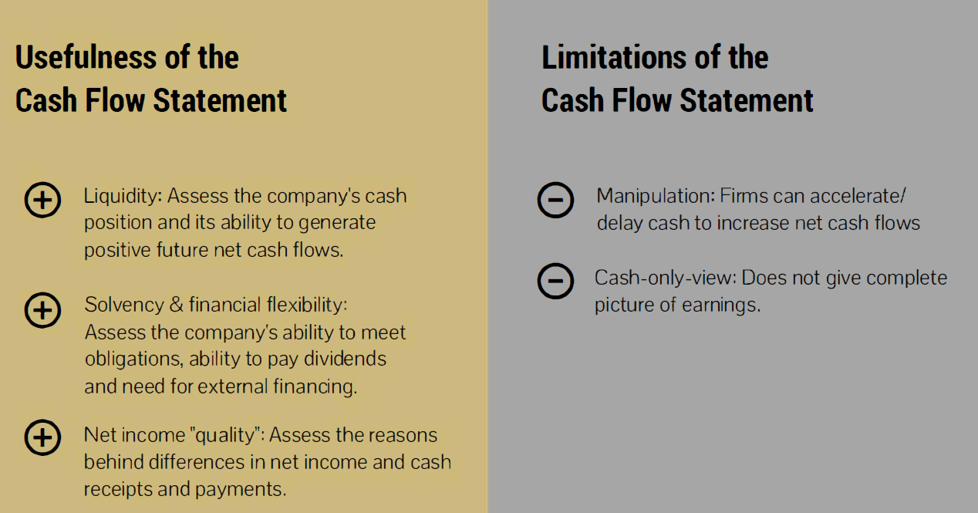
How are cash flows useful?

Slide 8
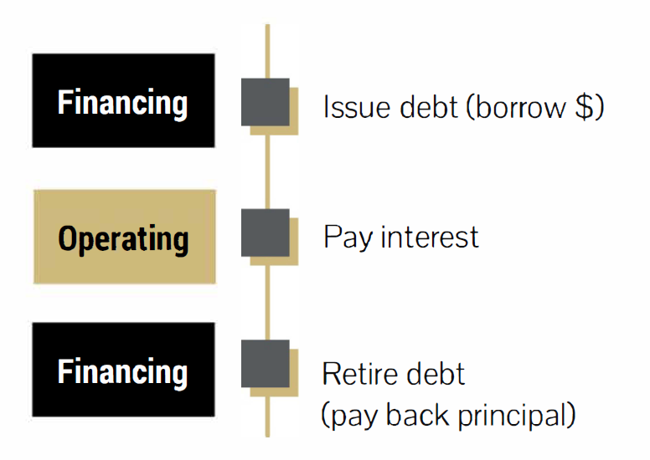
Unique classifications to be aware of: Debt

Slide 9
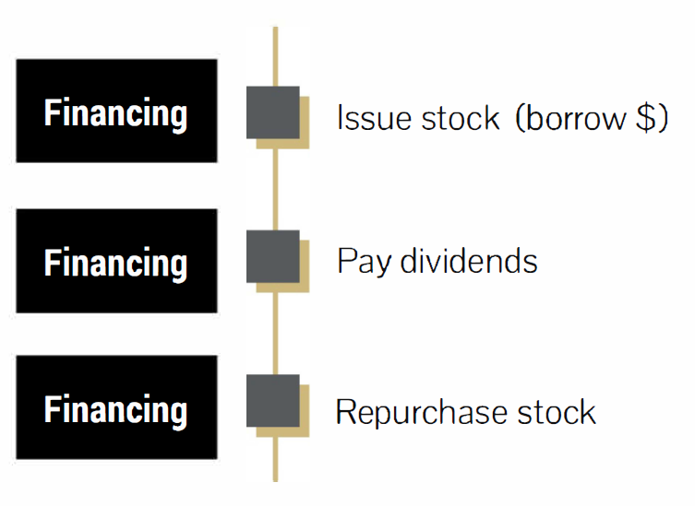
Unique classifications to be aware of: Equity

Slide 10
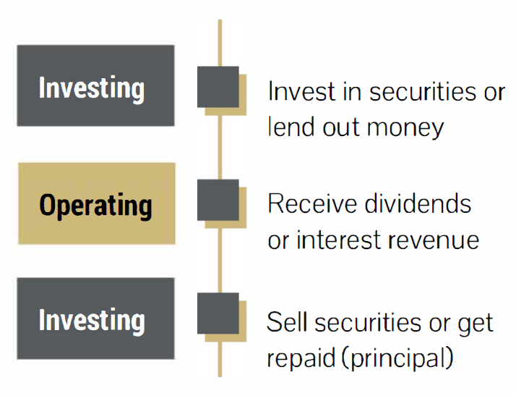
Unique classifications to be aware of: Investments

Slide 11
Closing Thoughts
Net income is not the same as cash flow – both matter!
The cash flow statement shows how we went from last year’s cash balance to this year’s cash balance
Cash flows are classified into operating, investing and financing activities

Slide 12
Cash Flow Statement Part 1 - Video

